Slide 1

Topic:Apple: A Leader in AI-powered Customer Satisfaction
How Apple uses AI to enhance its products, services, and customer experience

Slide 2
MEET OUR TEAM
ZAINAB RIAZ
BUSHRA WASEEM
SHAHMEER KHAN
MUSA TARIQ
MOIZ SHAHID

Slide 3

Apple as a company
Established in 1976 through Steve Jobs, Steve Wozniak, and Ronald Wayne, Apple Inc. Stands as a global leader inside the technology quarter, specializing in the layout, development, and sale of patron electronics, software, and offerings. In recent times,by Prioritizing sleek layout, intuitive interfaces, and non-stop innovation, Apple has cemented its status as an impressive entity inside the technological panorama.

Slide 4
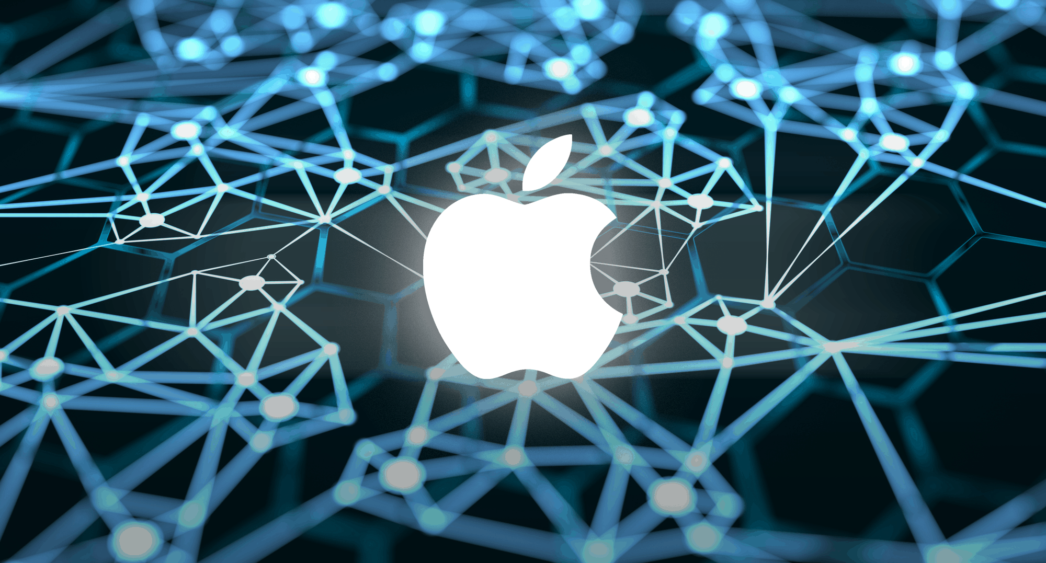
How Apple uses AI?
Apple's Integration of Artificial Intelligence: Apple Inc. Exhibits a steadfast determination to augmenting user studies and device functionality, underscored by way of its persistent funding in artificial intelligence (AI) research and development.

Slide 5
AI integration in Apple enterprise version
Siri:AI-Powered Virtual Assistant
Machine Learning in Apps
Predictive Text and Keyboard
Health and Fitness Tracking
Optimization and Battery Management
Recommendation Engines
Face ID and Biometrics
Apple integrates Ai with their various innovations and teachnologies.

Slide 6


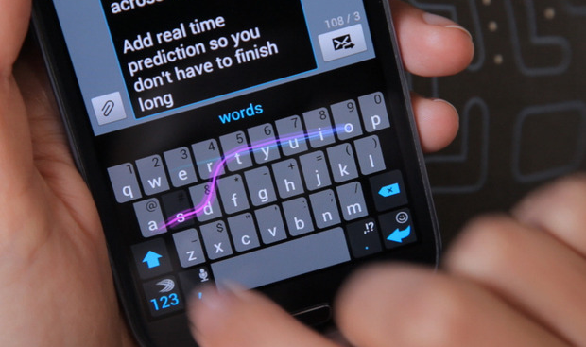
AI integrated technologies of Apple
Siri
Machine learning
Predictive Text and Keyboard
AI-powered digital assistant that helps user interaction with devices thru natural language processing
Integration of Machine Learning in Applications such as categorize snap shots, perform facial recognition, and propose enhancements to snap shots.
This innovation is powered by way of machine getting to know algorithms that adapt to individual typing patterns, showcasing Apple's dedication to enhancing consumer interplay with their devices.

Slide 7


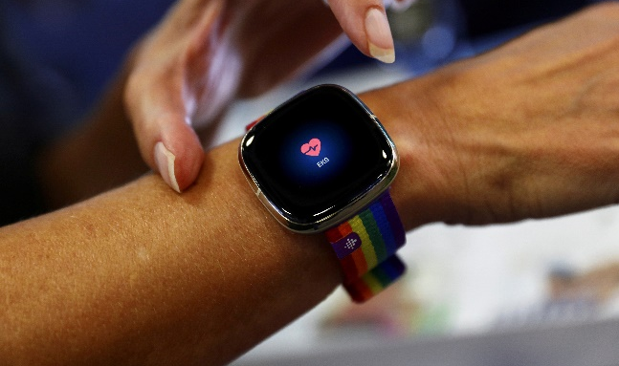
AI integrated technologies of Apple
Face id and biometrics
Recommendation engines
Health tracking and fitness
These complicated AI fashions are indispensable to the device, enhancing both the safety and the consumer enjoy of Apple gadgets.
These AI-primarily based structures analyze consumer preferences and behavioral patterns to curate tailored content guidelines throughout diverse Apple offerings, together with Apple Music, App Store, and Apple News.
Apple Watch and Health app for meticulous monitoring of health and health metrics.

Slide 8
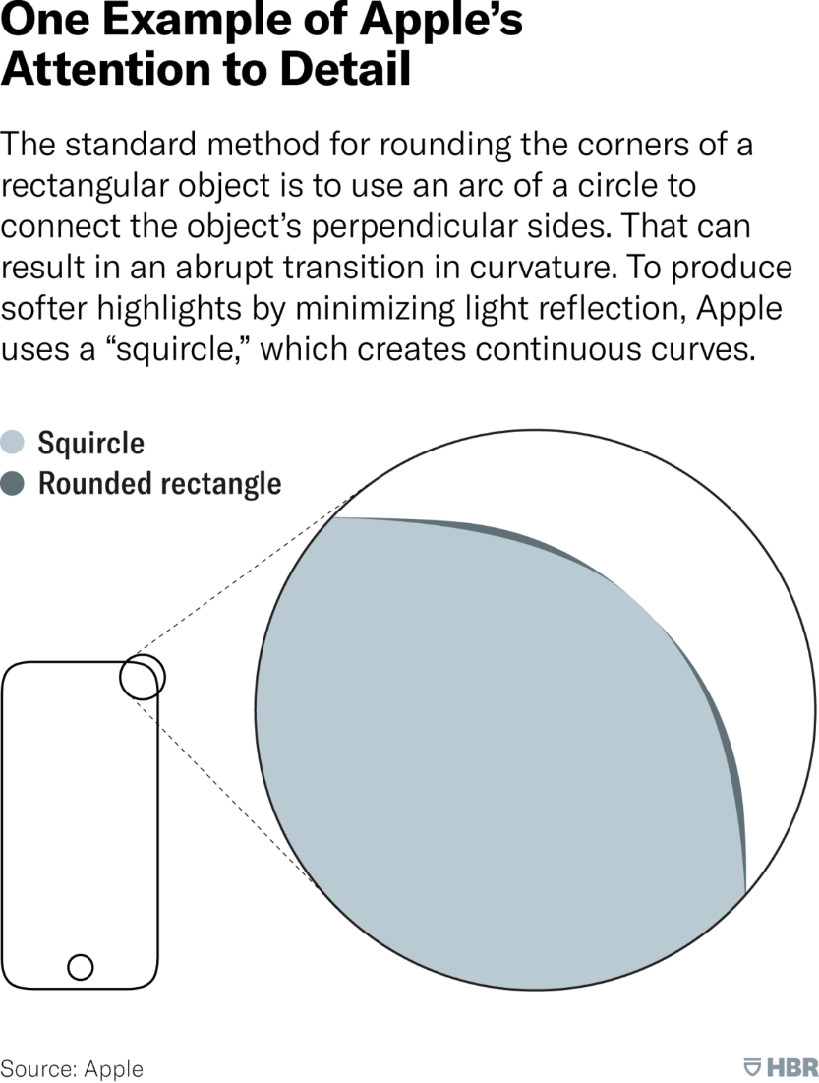
Attention to detail
This figure elaborates how much apple company focuses on the minor details.

Slide 9
Use of AI by Apple for customer satisfaction
Apple has used CRM to construct and hold relationships with its customers. Sending a sequence of emails to clients who have visited Apple stores is considered one of Apple’s fundamental advertising and marketing techniques; though, the cause of those emails isn't to promote it new products.

Slide 10
Apple strategic polices for customers
Customer acquisition
Customer experience
Digital marketing
Well-known shows an in-intensity know-how of its consumer base, correctly making use of its Customer Relationship Management (CRM) gadget which robotically collects facts when clients sign in for an Apple ID, allowing Apple to provide instructional and enlightening content material about the advantages in their merchandise.
Unlike conventional sales techniques, Apple stores awareness on encouraging clients to realize the value and blessings of merchandise along with iPhones, iPads, and Apple Watches, thereby adding extra intensity to the shopping experience.
The employer actively engages with its target market on social media, responding to feedback and queries. This interplay demonstrates Apple's willpower to valuing customer feedback, thereby fostering customer loyalty.

Slide 11
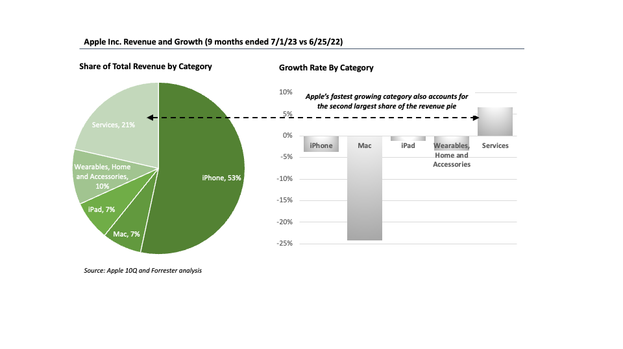
Apple strategic polices for customers
Online engagement:Customers visit the Apple website or retail stores without a doubt to discover products like iPhones, iPads, Macs, and greater. They can configure and personalize their favored devices.
This figure illustrates how beneficial services offered by Apple are in terms of growth

Slide 12
Implementations of AI by Apple
Siri and Natural Language Processing
Machine Learning in Applications
Facial Recognition (Face ID)
Predictive Text and Keyboard
Optimization and Battery Management
Recommendation Engines

Slide 13
Impacts of Apple's Incorporation of AI
Enhanced User Experience
Innovative Product Features
Optimized Device Performance
Personalized Recommendations
Health and Fitness Tracking

Slide 14
Lessons Learned from Apple's Approach
User-Centric CRM
Long-Term Customer Relationships
Digital Marketing and Online Engagement
Engagement through Social Media
AI in Innovative Solutions
Continuous Improvement

Slide 15
Conclusion
In summary, Apple Inc. is a global technology powerhouse known for innovation and user-centric design since its founding in 1976. The integration of artificial intelligence, including Siri and facial recognition (Face ID), reinforces its technological leadership. Apple prioritizes user experience, privacy, and data security through AI research. The use of CRM is crucial for customer satisfaction, employing strategies in acquisition, experience, and digital marketing. Online engagement, iconic branding, and responsiveness on social media contribute to strong customer loyalty. Apple's dedication to cutting-edge solutions, like ARKit for augmented reality, showcases its continuous pursuit of technological excellence, making it a leader in the evolving tech landscape.

